Slide 1
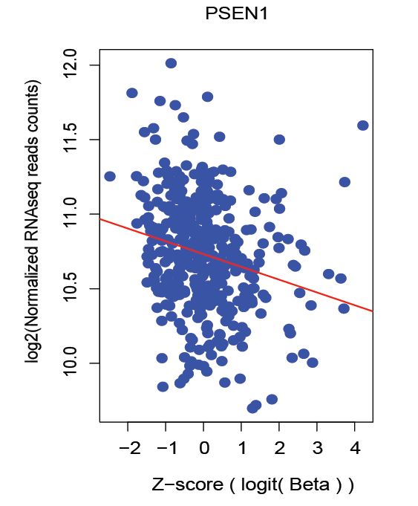
_{Y=3.42-0.012X}
_{P=4.2x10}-6

